Slide 1
NE 591: Advanced Reactor Materials
Fall 2021
Dr. Benjamin Beeler

Slide 2
Last Time
Wrapped up Molten Salts
Distribution of fission products is a central safety issue, and fission products may be gaseous, solid, or dissolved
The materials required fall into three main categories: (1) metallic components for primary and secondary circuits, (2) graphite (or other structural steels) in the core, and (3) materials for molten-salt fuel reprocessing systems
Primary focus on Ni-based alloys for a wide variety of salt-facing components
Graphite can be readily used and has experience in the core
Corrosion challenges change depending upon the reactor type/design

Slide 3
dft for nuclear fuels

Slide 4
Density Functional Theory
The theoretical foundations of DFT were set in the 1960s by the works of Hohenberg and Kohn
They proved that the determination of the ground-state wave function of the electrons in a system can be replaced by the determination of the ground-state electronic density
The density is expressed as the sum of squared single particle wave functions, these single particles being fictitious noninteracting electrons
An assembly of interacting electrons has been replaced by an assembly of fictitious noninteracting particles

Slide 5
Density Functional Theory
The electronic interactions are gathered in a one-electron term called ‘the exchange and correlation potential,’ which derives from an exchange and correlation functional of the total electronic density
No exact formulation exists for this exchange and correlation (XC) functional, so we utilize approximations
One finally obtains a set of one-electron Schrodinger equations, whose terms depend on the electronic density
This is the basis of DFT, and referred to as ab initio (from first principles) calculations, despite relying on several assumptions or simplifications

Slide 6
LDA/GGA
The simplest approximation for the XC functional is the local density approximation (LDA)
In the LDA, the density of the XC energy at a given point depends only on the value of the electronic density at this point
Generalized Gradient Approximation (GGA) functionals introduce in the XC energy an additional term depending on the local gradient of the electronic density
Most of the ab initio calculations in materials science are performed with these functionals

Slide 7
K-points and Pseudopotentials
For materials science applications, most calculations are done for periodic systems, that is, one considers a cell periodically repeated in space
Bloch theorem then ensures that the electronic wave functions should be determined only in the irreducible Brillouin zone, which is in practice sampled with a limited number of so-called k points
Pseudoization is based on the assumption that it is possible to separate the electronic levels in valence orbitals and core orbitals
Core electrons are supposed to be tightly bound to their nucleus and are unaffected by the chemical environment while valence electrons fully participate in the bonding
The interaction between the valence electrons and the ion made of the nucleus and core electrons is replaced by a pseudopotential of interaction

Slide 8
Pseudopotentials
Many important codes use plane waves as their basis set, where the wave functions are decomposed into plane waves
This choice is based on the ease of performing fast Fourier transform between direct and reciprocal space, which allows rather fast calculations
One can distinguish norm-conserving pseudopotentials, ultrasoft pseudopotentials, and projector augmented wave (PAW) formalism
PAW allows the reconstruction of the real electronic density and the real wave functions with all their oscillations, and can thus be considered an all-electron method

Slide 9
Outputs
The basic output of a standard ab initio calculation is the complete description of the electronic ground state for the considered atomic configuration
This includes the electronic density of states, which indicates bandgap, magnetism, optical absorption, X-ray spectra, etc.
Total system energy, forces on individual atoms, stress tensor, etc. can be used to determine local spatial minima, phonon spectrum, saddle points, and time integration (when coupled to molecular dynamics)

Slide 10
Computational Expense
The calculation time of ab initio calculations varies as the cube of the number of electrons in the cell
This strongly limits the number of atoms and also the cell size that can be considered
The present upper limit in the number of atoms that can be considered is of the order of a few hundred
The CPU time needed to complete an ab initio study (which most of the time involves various starting geometry) may amount up to hundreds of thousands or millions of CPU hours

Slide 11
Choices
One needs to provide more inputs than just the atomic positions and types
Blind use of ab initio codes may lead to disappointing errors
Input values often require tuning from the defaults to provide meaningful descriptions
Choice of XC functional: LDA calculations tend to overestimate the bonding and underestimate the bond length in bulk materials, the opposite for GGA
Choice of pseudopotential
K-point sampling
Number of plane waves
Convergence criteria
Others…

Slide 12
Calculations
Nuclear materials of interest that have been studied include metals, particularly iron, tungsten, zirconium, and plutonium; Fe alloys, especially iron alloys; fuels UO2, U–PuO2, and uranium carbides; structural carbides (SiC, TiC, B4C, etc.); waste materials (zircon, pyrochlores, apatites, etc.)
Bulk crystal crystallographic and electronic structure
Input for thermodynamic models, phase stabilities, solubilities, etc.
Point defects including vacancies, interstitials, extrinsic particles, defect clusters, migration energies
Threshold displacement energies, electronic stopping power

Slide 13
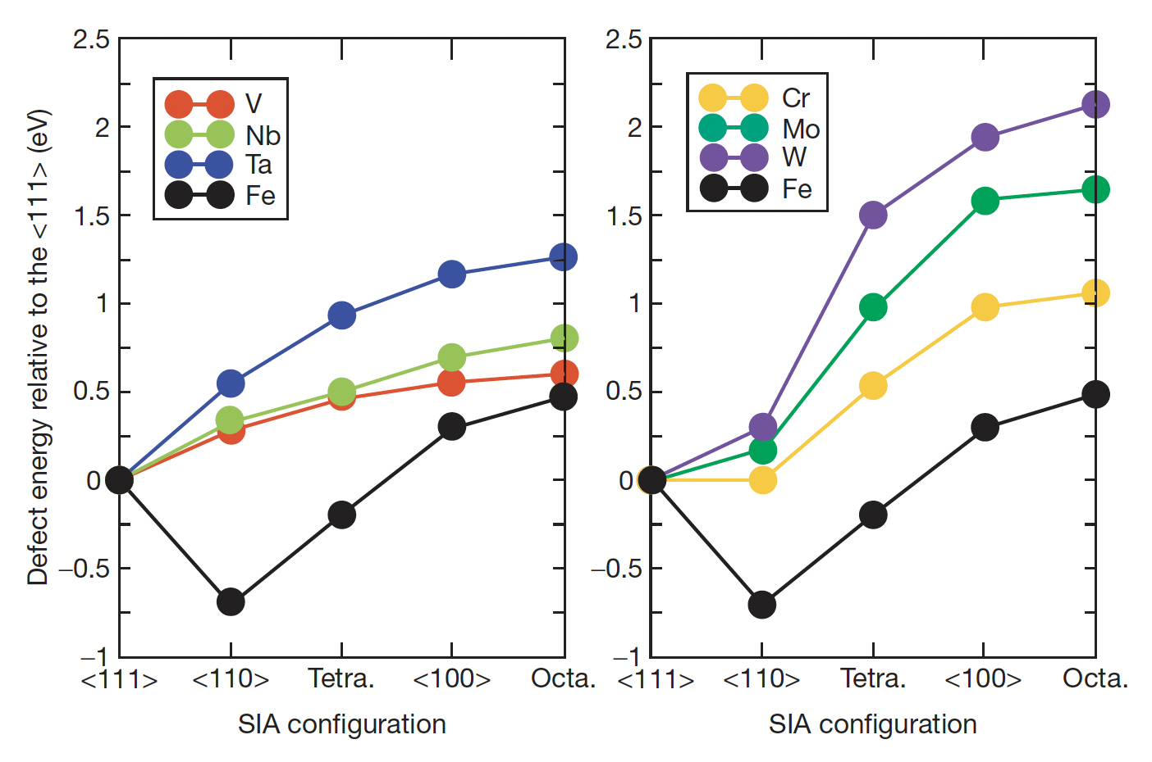
Metals
The vast majority of DFT calculations on radiation defects in metallic materials have been performed in body-centered cubic (bcc) iron-based materials
DFT calculations have been intensively used to predict atomistic defect configurations and also transition pathways
DFT calculations showed that interstitial helium is located on tetrahedral sites, not only in iron, but also in all other bcc metals, improving accuracy of empirical potentials

Slide 14
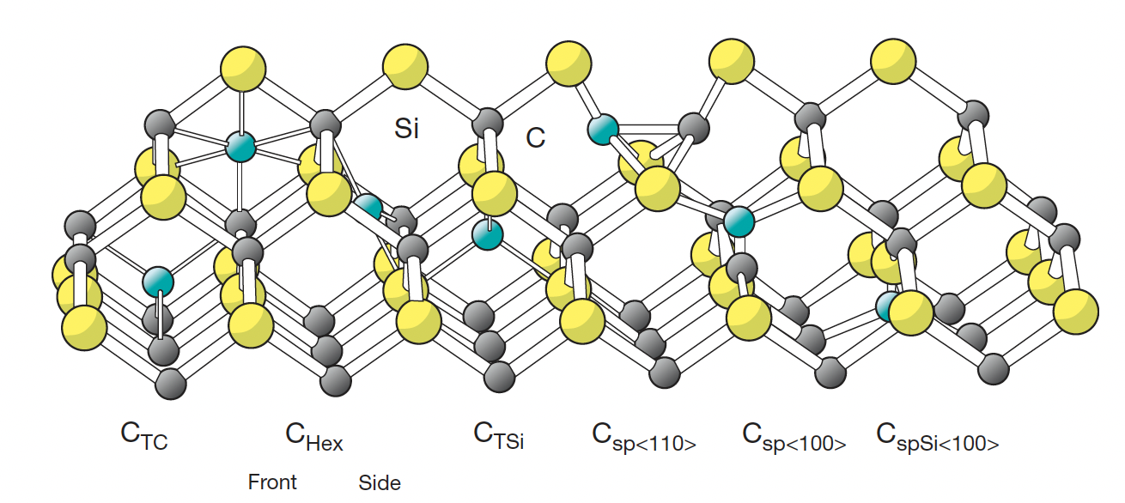
Insulators
It is legitimate to distinguish between electrically conducting materials on one hand and insulating or semiconducting materials
Due to the existence of a gap in the electronic density of states, the point defects may be charged, and the properties of the point defects can depend on their charge state
Silicon carbide is a band insulator whose bulk structural properties are well reproduced by usual DFT calculations
Vacancies, interstitials, and extended defects have all been explored in beta SiC
Errors in bandgap prediction lead to errors in defect configuration

Slide 15
Uranium Oxide
Due to its technological importance and the complexity of its electronic structure, uranium oxide has become one of the test cases for beyond DFT methods
UO2 is a ceramic insulator, but is predicted to be a metal from its electronic structure as calculated with LDA or GGA
f electrons are localized on uranium atoms and are not spread over the material as usual valence electrons are
The first correction that has been applied is the LDA+U correction in which a Hubbard U term acting between f electrons is added
This method allows the opening of an f–f gap

Slide 16
Uranium Oxide
Hybrid functionals are another type of advanced methods that are very often used in the quantum chemistry community
Their principle is to mix a part of Hartree–Fock exact exchange with a DFT calculation
The problem of the presence of a number of metastable states exists for both LDA+U and hybrid functionals, leading to difficulty in finding the true ground state
The computational load for hybrid functionals is much heavier than that in common or LDA+U calculations

Slide 17
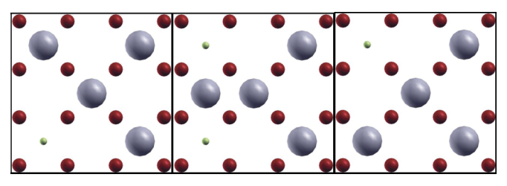
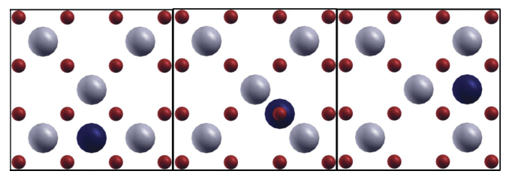
UO2 defects
Composite defects have primarily been studied; charge neutral Frenkel pairs and Schottky defects
Some studies on charged defects have also been performed
There is wide scatter in the data on defect formation energies in UO2, likely related to metastable states
Defect migration studies have also been performed
Vacancy Diffusion
Interstitial Diffusion

Slide 18
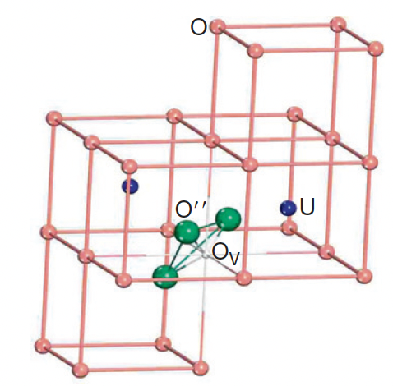
Oxygen Clustering
Oxygen interstitial clusters have been identified in UO2 experimentally and explored computationally
Computational work has shown the collapse of Willis clusters to a three interstitial-one vacancy split di-interstitial type cluster

Slide 19
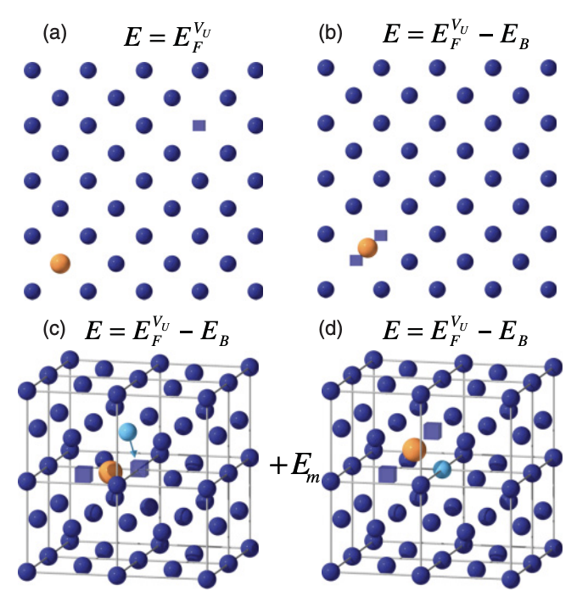
Xe in UO2
When considering extrinsic particles, one must distinguish between the incorporation energy, defined as the energy to incorporate the FP in a preexisting vacancy site, and the solution energy, which is relevant for full thermodynamic equilibrium, which accounts for the number of available vacant sites
One then adds to the incorporation energy the so-called apparent formation energy, which is defined as the logarithm of the vacancy concentration multiplied by the temperature

Slide 20
Xe in UO2
Both solution energies and diffusion pathways for Xe via a vacancy mechanism have been determined through DFT+U approaches
Xe transport occurs by binding a second U vacancy to the stable Xe trap sites and these clusters then migrate according to a vacancy mediated mechanism, which occurs due to the fact that the U vacancy is bound to the Xe trap sites

Slide 21
Quantum Espresso
QE is a suite of Open-Source computer codes for electronic-structure calculations and materials modeling at the nanoscale
QE is based on density-functional theory, plane waves, and pseudopotentials
We will be using QE for our year-end project
https://www.quantum-espresso.org/
Shehab will give a practical overview of QE next Tuesday
Calculations will be performed on the rdfmg cluster
You will need to compile the code yourself
Try this on your own, and then come to me if it fails

Slide 22
Project Description
Theoretical FCC U structure
Convergence study on cutoff energy
Convergence study on kpoint mesh
What is the effect of +U on elastic constants? For U values of 0, 1, 2, 3, 4 eV
Include spin polarization
Written report, no more than 10 pages, Times New Roman 11pt, 1.5 spacing
Submission via Moodle, including input files

Slide 23
Next Time
Presentations!
Will send feedback on first presentations today, sorry for the delay

